Slide 1
Introduction to DevOps

Slide 2
Agenda
Why DevOps?
What is DevOps?
Core Concepts of DevOps
DevOps Lifecycle
DevOps Principles
DevOps Tools
Learning Path
Important Links

Slide 3

Why DevOps?

Slide 4
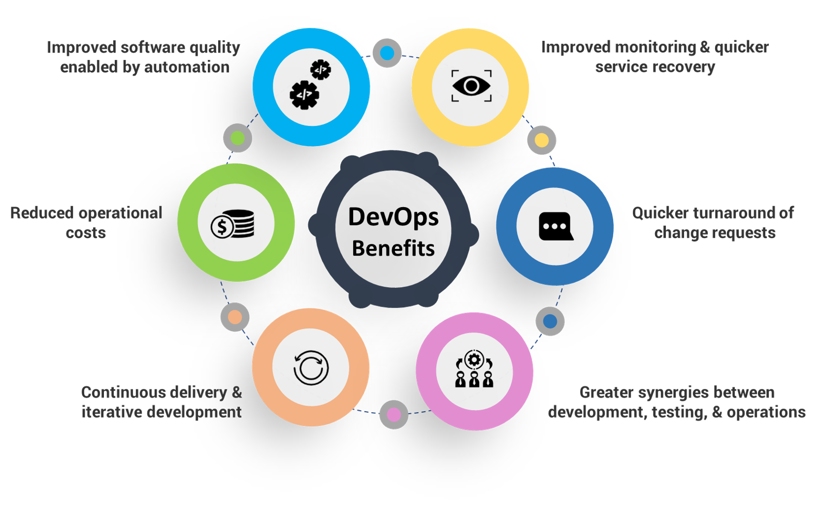
Why DevOps?

Slide 5
What is DevOps?

Slide 6
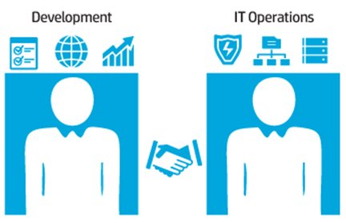
What is DevOps?
DevOps is the combination of cultural philosophies, practices, and tools that increases an organization’s ability to deliver applications and services at high velocity.
Culture + Practices + Automation, not just tools

Slide 7
Core Concepts of DevOps

Slide 8
Core Concepts of DevOps
Cultural Aspect:
Breaking silos, Dev + Ops + QA + Security working together
Shift-left testing, ownership mindset
Process Aspect:
CI, CD, IaC and Monitoring and Observability
Business Aspect:
Faster time-to-market, Improved reliability, Reduced costs

Slide 9
DevOps Lifecycle

Slide 10
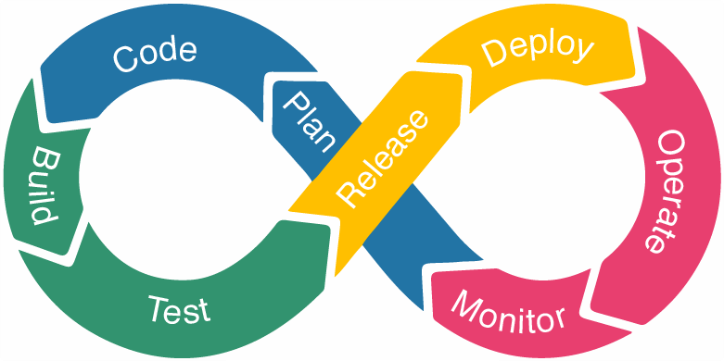
DevOps Lifecycle

Slide 11
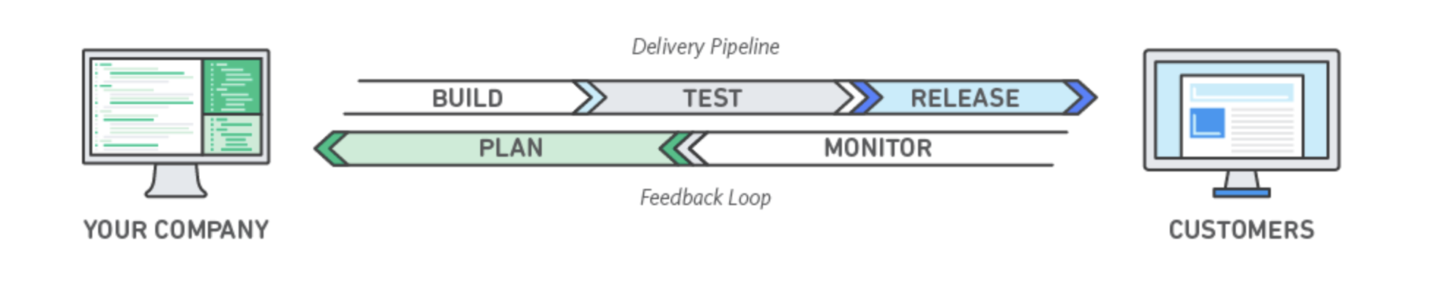
DevOps Lifecycle

Slide 12
DevOps Principles

Slide 13
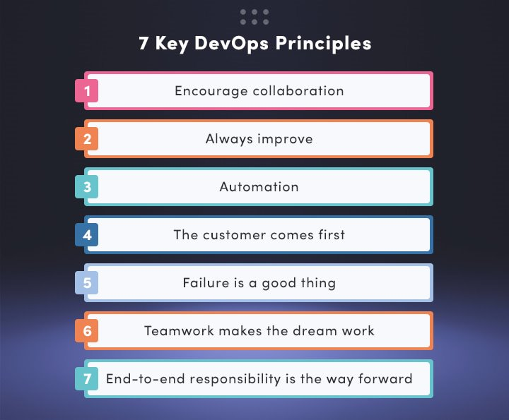
DevOps Principles

Slide 14
DevOps Tools

Slide 15
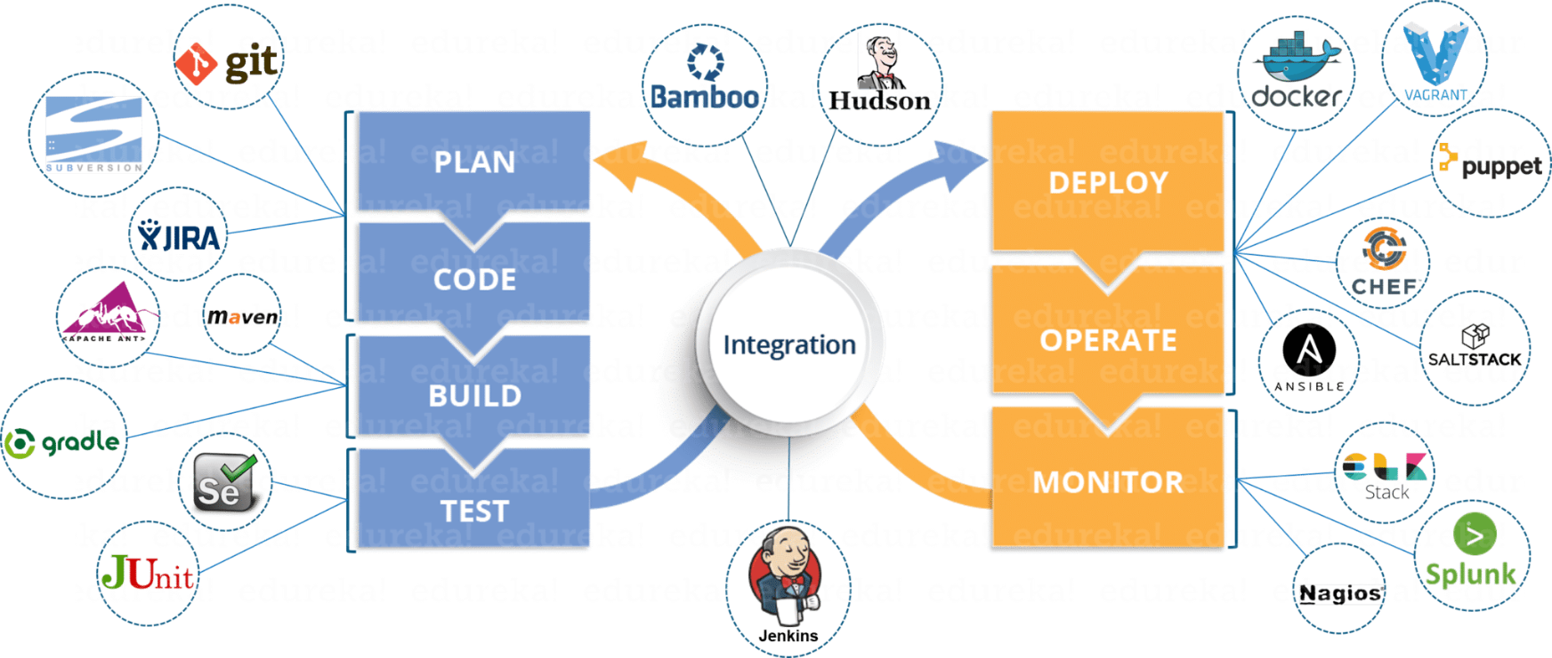
DevOps Tools

Slide 16
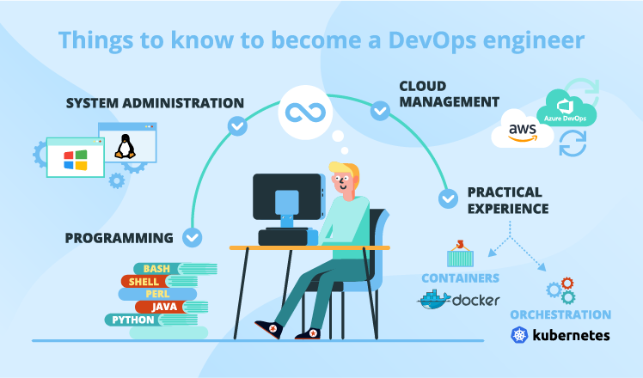

Slide 17
Important Links
https://aws.amazon.com/devops/what-is-devops/
https://learn.microsoft.com/en-us/devops/what-is-devops
https://www.atlassian.com/devops

Slide 18
Important Links
 | Links
Roadmap | https://roadmap.sh/devops https://roadmap.sh/devops?r=devops-beginner
DevOps Content | https://devops.com/ https://www.reddit.com/r/devops/
OpenSource and Contributions | https://opensource.com/ https://clotributor.dev
Opinionated guides | https://www.thoughtworks.com/en-in/radar/tools
Hands-on Practice | https://learngitbranching.js.org/ https://sadservers.com/
Others | https://fediverse.party

Slide 19
Q & A

Slide 20
Thank You

